Slide 1
INDIAN INSTITUTE OF INFORMATION TECHNOLOGY-KALYANI
MINI TEACHING SESSION
(COMMUNICATION SYSTEMS)

Slide 2
BY-RAJAT SHUKLA(ROLL NO:37)
TOPIC-SUPERHETERODYNE RECEIVER

Slide 3
OVERVIEW
DEFINITION
STRUCTURE AND DESCRIPTION OF EACH PART
WORKING
NUMERICALS
USES IN MODERN DAY

Slide 4
DEFINITION OF SUPERHETERODYNE RECEIVER

Slide 5
In electronics, a superheterodyne receiver (often shortened to superhet) uses frequency mixing to convert a received signal to a fixed intermediate frequency (IF) which can be more conveniently processed than the original carrier frequency.

Slide 6
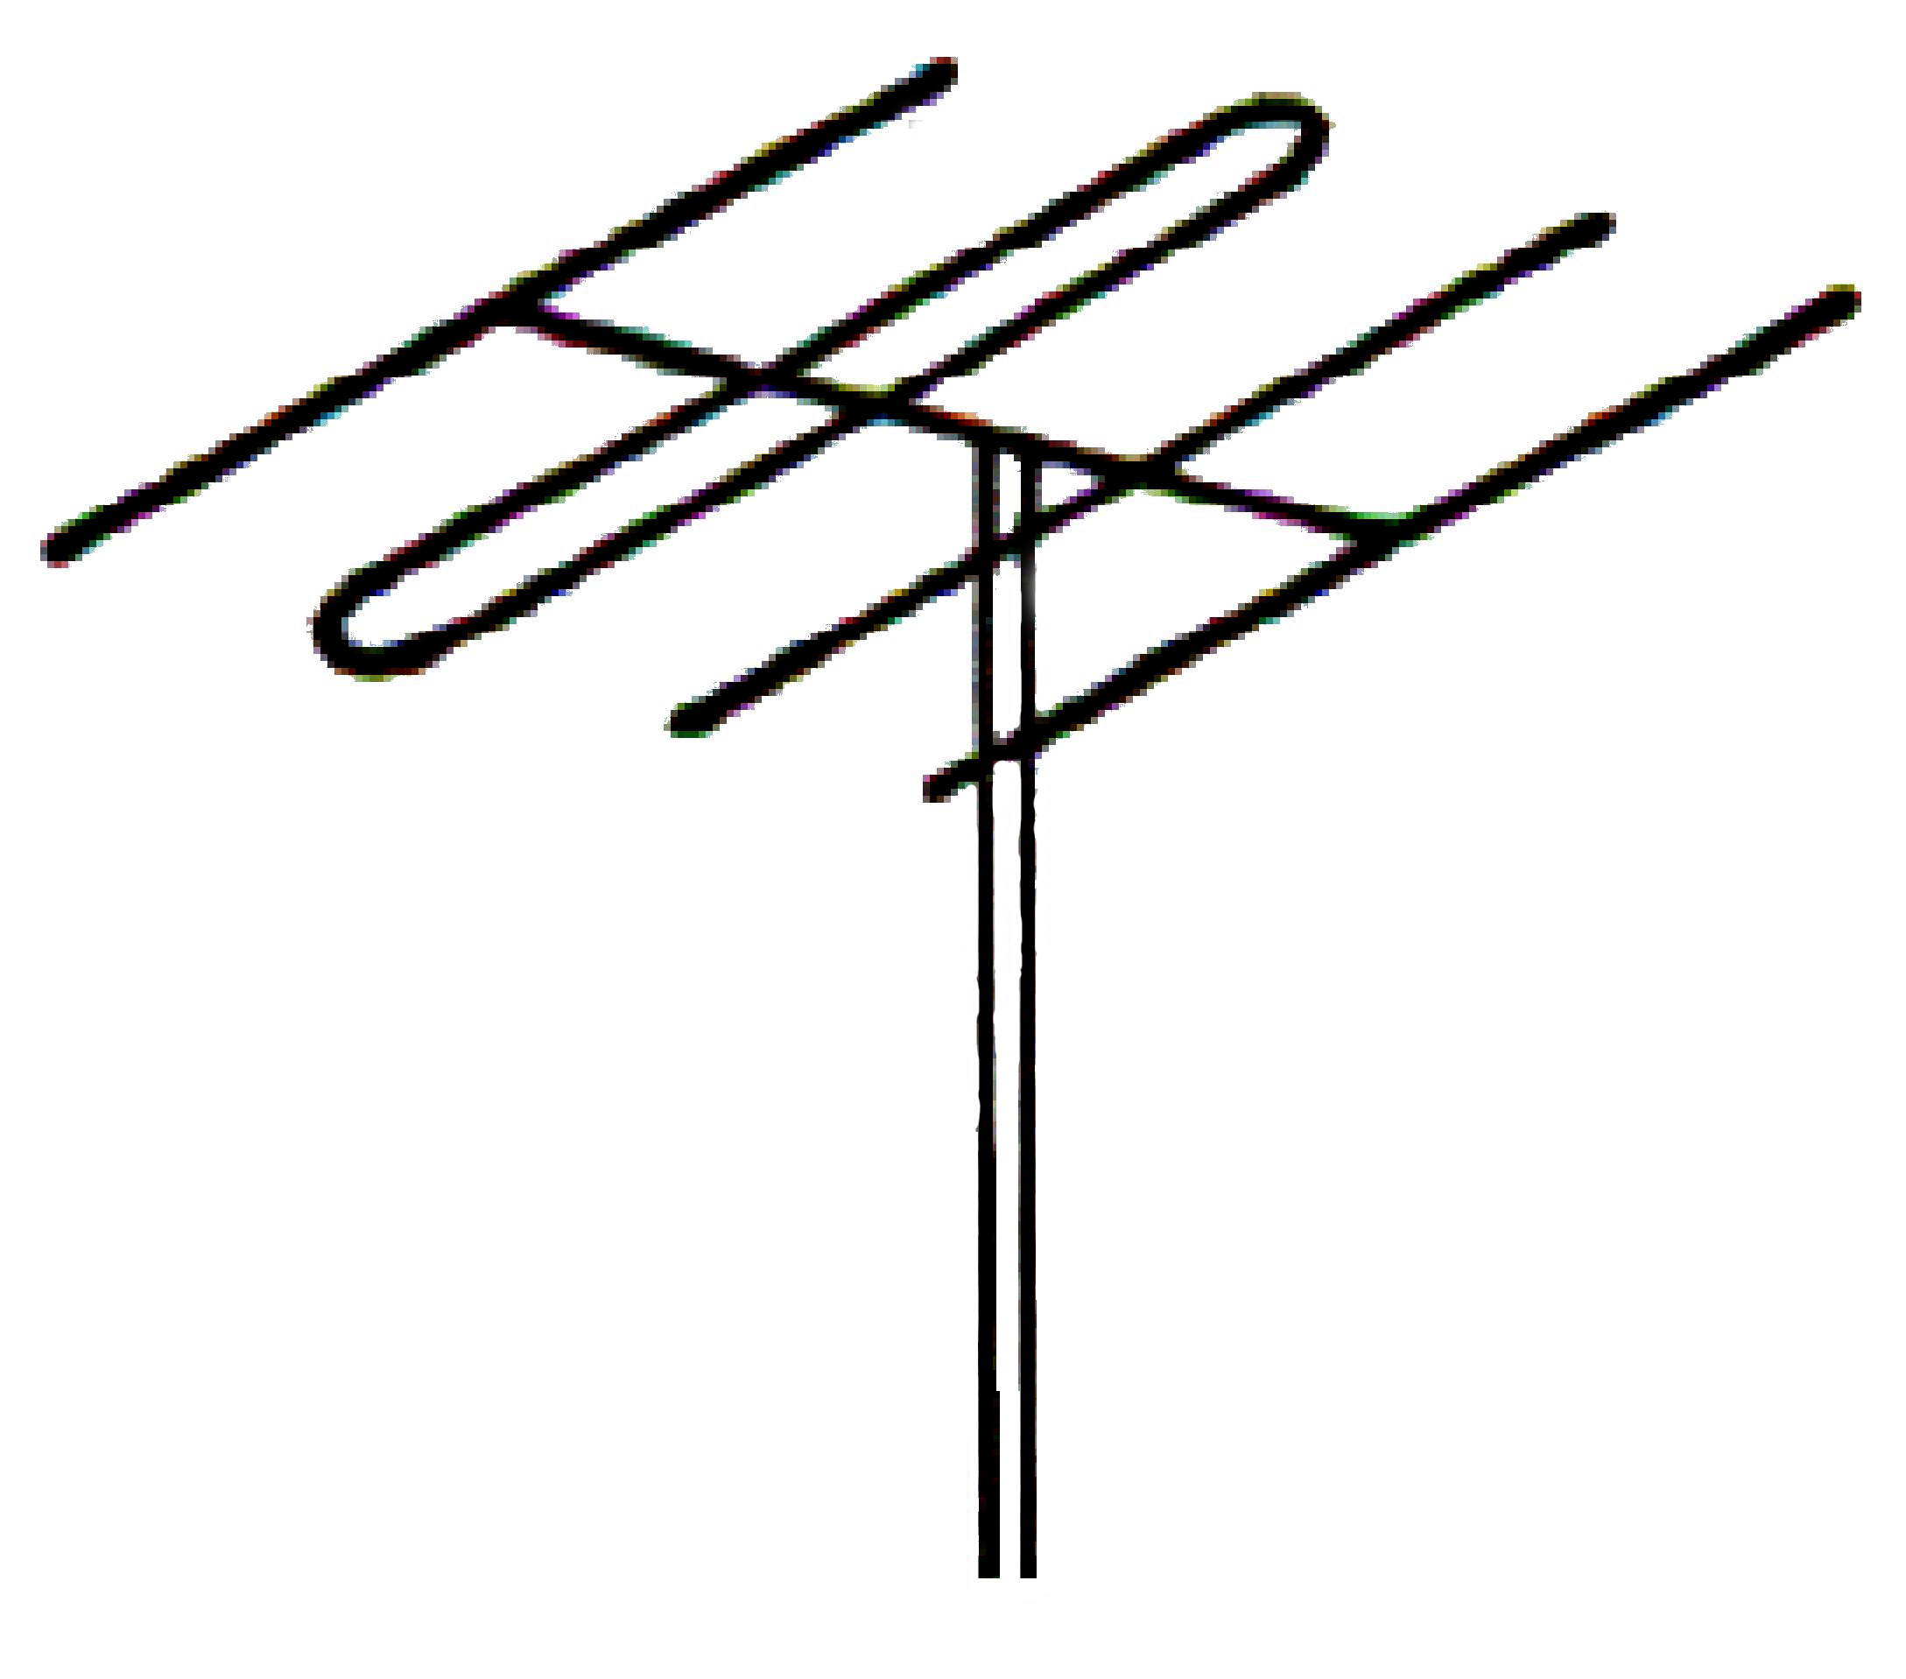
Structure-
Antena
RF Amplifier with bandpass filter tunable
Mixer
(frequency converter)
IF amplifier and filter
Demodulator
Local Oscillator
AF Amplifier
Original
information

Slide 7
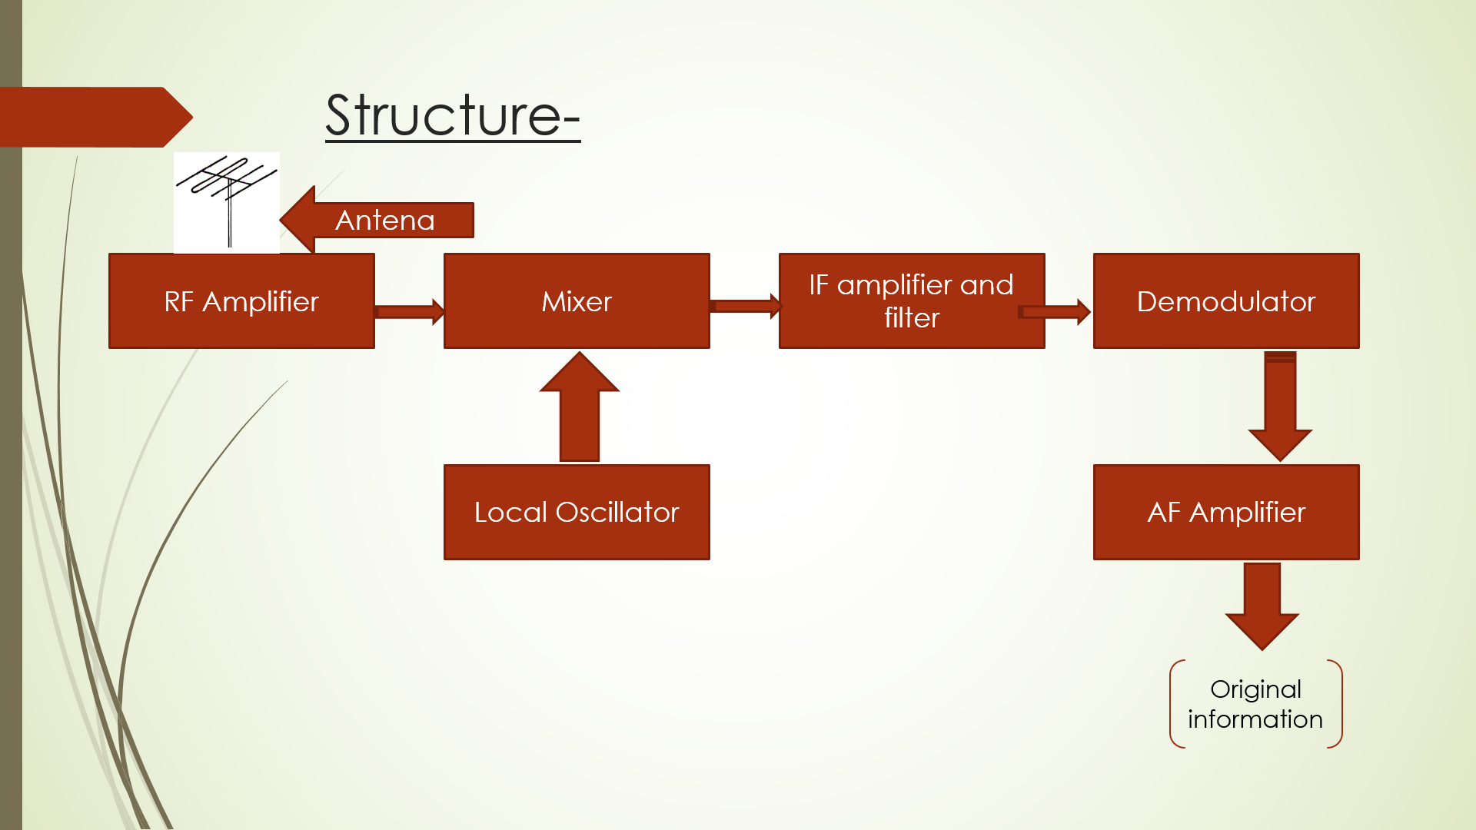
Parts ofSuperheterodyne receiver
-RF Amplifier
-Local oscillator
-mixer
-IF amplifier
-Demodulator and AF amplifier

Slide 8
RF Amplifier:- A radio frequency power amplifier (RF power amplifier) is a type of electronic amplifier that converts a low-powerradio-frequency signal into a higher power signal. Typically,RF power amplifiers drive the antenna of a transmitter.

Slide 9
Local oscillator:- In electronics, a local oscillator (LO) is an electronic oscillator used with a mixer to change the frequency of a signal. This frequency conversion process, also called heterodyning, produces the sum and difference frequencies from the frequency of the local oscillator and frequency of the input signal.

Slide 10
Mixer:- Mixer mixes the frequency of RF amplifier and local oscillator . The mixer uses a non-linear component to produce both sum and difference beat frequencies signals, each one containing the modulation contained in the desired signal. The output of the mixer may include the original RF signal at f_{RF}, the local oscillator signal at f_{LO}, and the two new heterodyne frequencies f_{RF} + f_{LO} and f_{RF} − f_{LO}.

Slide 11
IF Amplifier:- A frequency to which a carrier wave is shifted as an intermediate step in transmission or reception and the amplifier used to amplify this frequency is known as IF amplifier. In communications -if frequency is fixed. For fm-10.7Mhz for AM-455 khz for tv 38 mhz

Slide 12
DEMODULATOR:- Demodulator converts electromagnetic signal to audio signal.

Slide 13
AF amplifier:- Audio amplifier amplifies the audio signal and drives the speaker to produce sound.

Slide 14
WORKING OF SUPERHETERODYNE RECEIVER

Slide 15
Working-
Antena
RF Amplifier
Mixer
IF amplifier and filter
Demodulator
Local Oscillator
AF Amplifier
Original
information

Slide 16
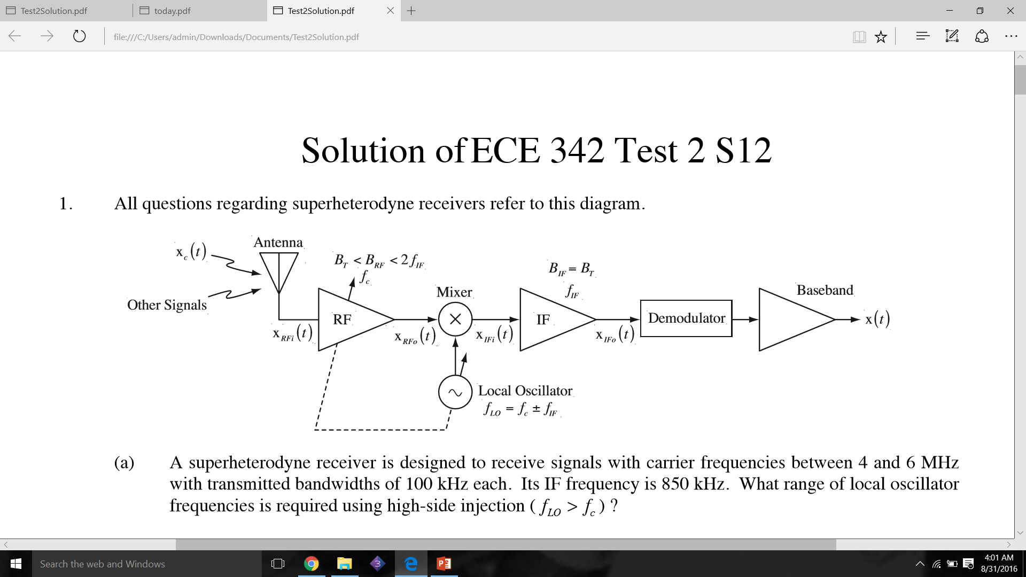

Slide 17
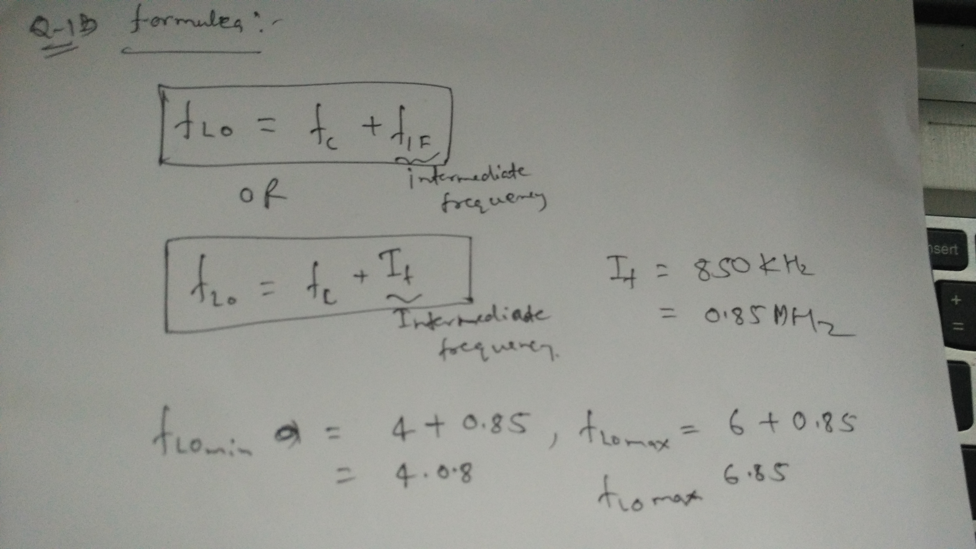

Slide 18
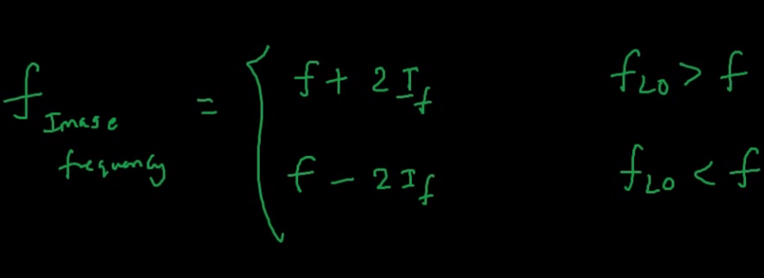
Image frequency:- An image frequency is any frequency other than the selected radio frequencycarrier that ,if allowed to enter a receiver and mix with the local oscillator ,will produce a cross product frequency that is equal to the intermediate frequency.

Slide 19
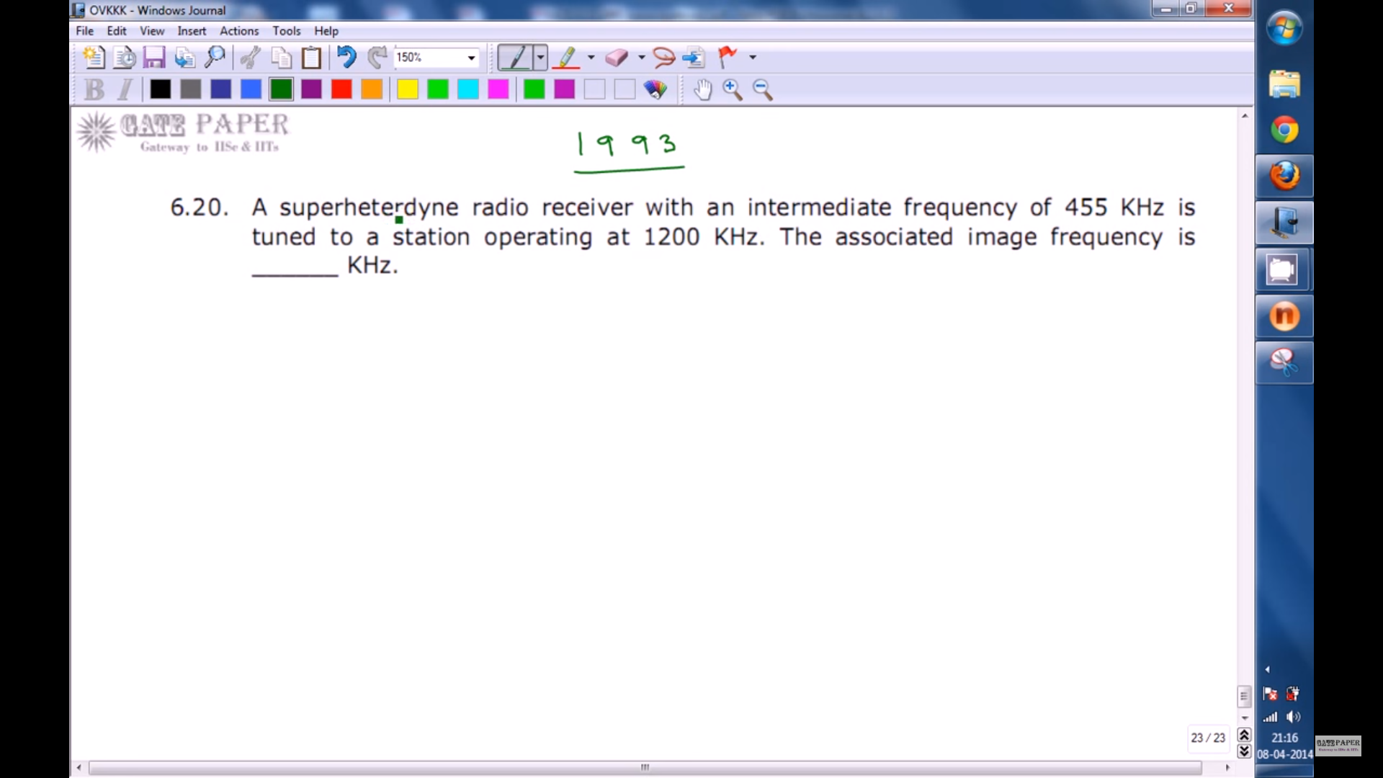
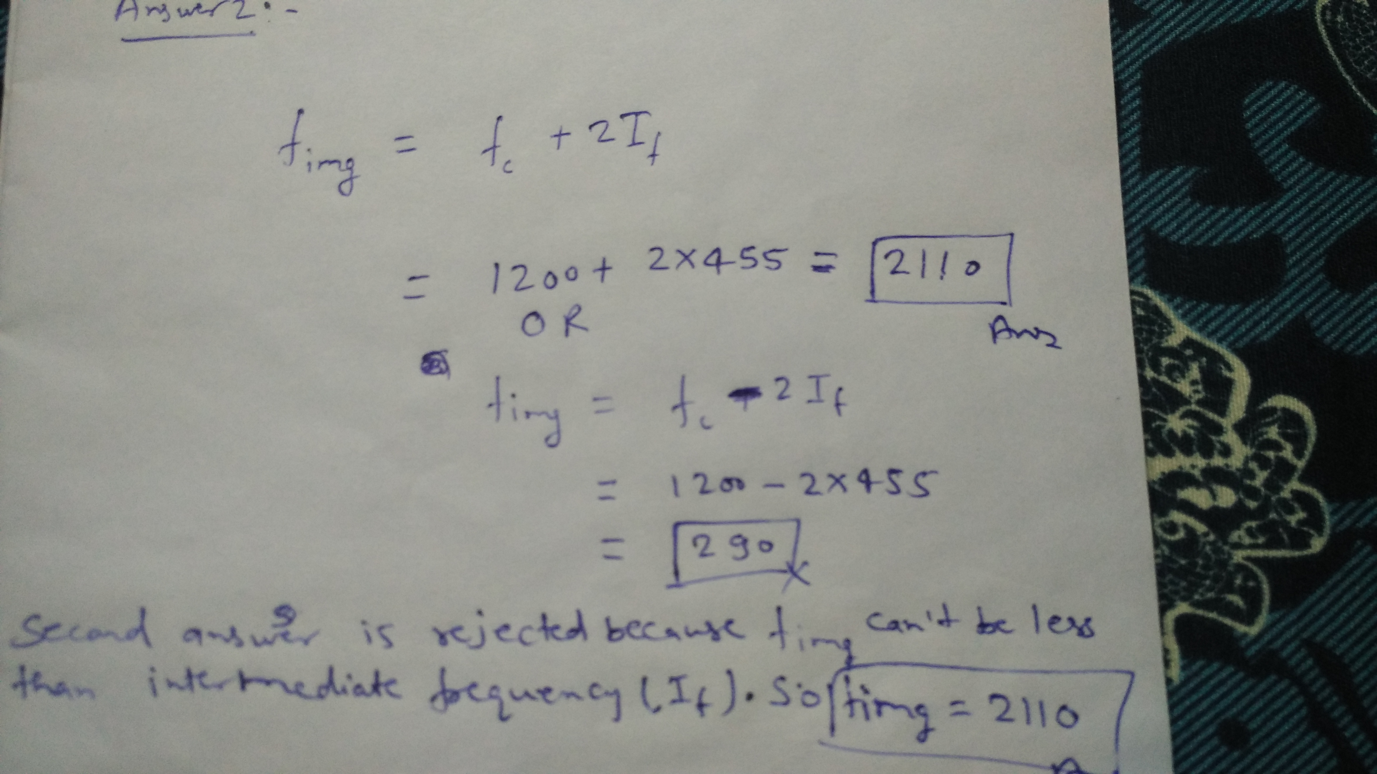
Next question is on the same concept

Slide 20
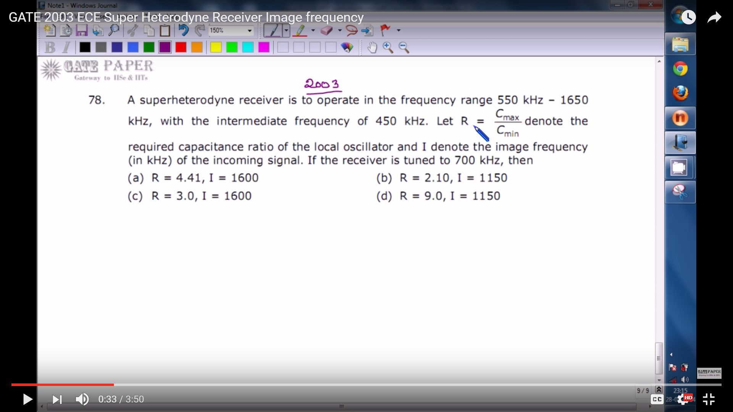

Slide 21
Use of superheterodyne receiver in modern day
Superheterodyne receiver technology is used in FM& AM Broadcasting and also in Telivisions.

Slide 22


